Slide 1
Follow the Yellow-Brick Code
A FHIR Terminology Journey
Dr Jim Steel | Team Leader, Health Data & FHIR
23 November 2021
Australian E-Health Research Centre

Slide 2

Who am I?
Jim Steel
Team Leader, Health Data & FHIR CSIRO Australian e-Health Research Centre
Software Engineer on Ontoserver

Slide 3
What we will cover today
Follow some coded data through a journey, including
How the codes get found in the first place
What they look like on the wire
How they get validated on receipt
How they get queried
Images from Project Gutenberg http://www.gutenberg.org/ebooks/43936
Notes:
The book was published in 1900 and is (unlike the film) in the public domain, including its illustrations

Slide 4
FHIR Terminology resources
$expand $validate-code
Concept Map
A (one way) mapping from a set of concepts to one or more other concepts
N
N
Value Set
A selection of a set of codes for use in a particular context
Target
Value Set
A selection of a set of codes for use in a particular context
Selects
from
Source
N
src | rel | tgt
Selects
from
N
Code System
A set of concepts with a coherent meaning
url, version, name, …
Filters, Properties
Concepts
Code
Display
Definition
Code System
A set of concepts with a coherent meaning
url, version, name, …
Filters, Properties
Concepts
Code
Display
Definition
$translate $closure
$lookup $validate-code $subsumes
Notes:
Brief introduction to the resources, then the operations, most of which we’ll see illustrated as we tell our story

Slide 5
Terminology API in a FHIR Architecture
As part of a standard FHIR server
Simple, easy for clients
Separate terminology server
Single source of truth for multiple FHIR systems
Both servers behind a façade
Simple and single source of truth
FHIR server integrated with a terminology server
Simple and single source of truth
FHIR server can support terminology-aware search, validation
Notes:
Lots of contexts in which you will see the terminology services API, with different architectural benefits

Slide 6
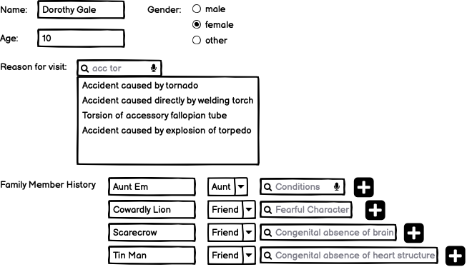
Step 1: Dorothy makes an appointment with Dr Oz
Notes:
Patient registers to see a doctor, she’s been hit on the head during a tornado.
Gender, Reason for Visit, Family Member History relationship and conditions are all coded
”Friend” is not normally a valid family relationship, but this UI has allowed it

Slide 7
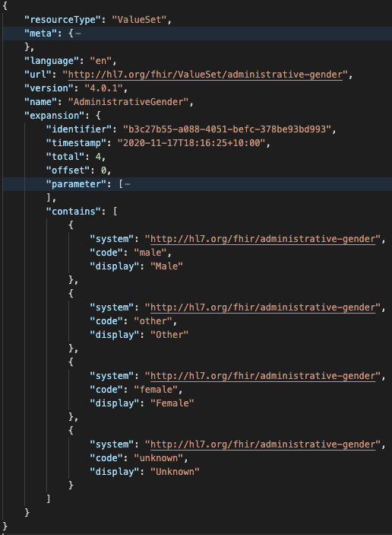
Get gender options
GET ValueSet/$expand? url= http://hl7.org/fhir/ValueSet/administrative-gender
Notes:
First view of $expand
We can choose which ValueSet by specifying a URL
When we use $expand, the response comes back as a ValueSet with the expansion element populated
Order of concepts in the result is up to the server

Slide 8
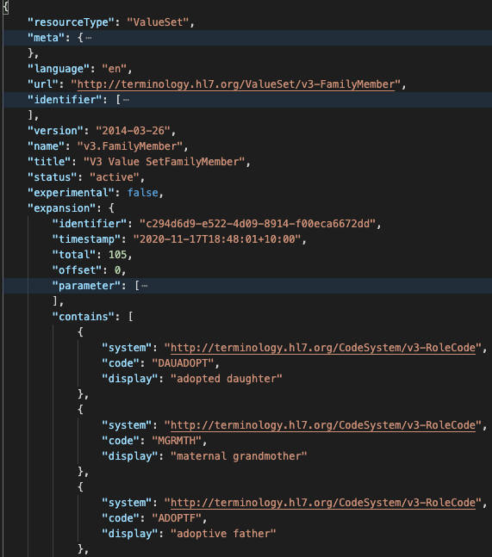
Get Family Member Relationships
GET ValueSet/$expand? context=FamilyMemberHistory.relationship
Notes:
Alternatively we can provided the context, i.e. the FHIR element we’re interested in
The server will know what ValueSet is bound to that element.

Slide 9
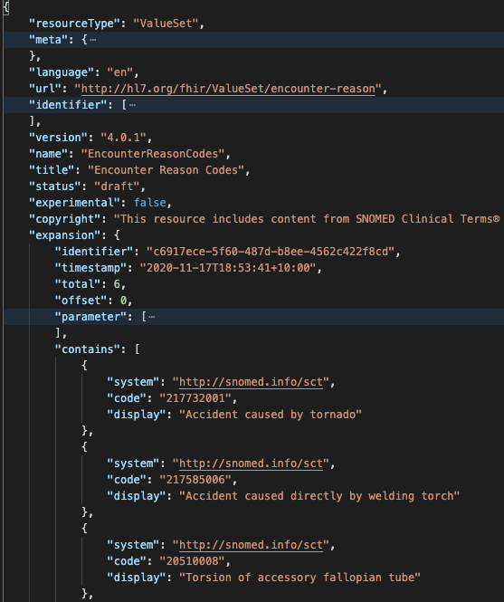
Search for reason for visit
GET ValueSet/$expand? context=Encounter.reasonCode& filter=acc tor
Notes:
Reason for visit might have more than 100k possible codes
For large ValueSets like this, we need to narrow down the selection using something like typeahead
We can use the “filter” parameter for this. It is up to the server how it treats this parameter value when its determining which codes in the ValueSet match
Multi prefix any order is great

Slide 10
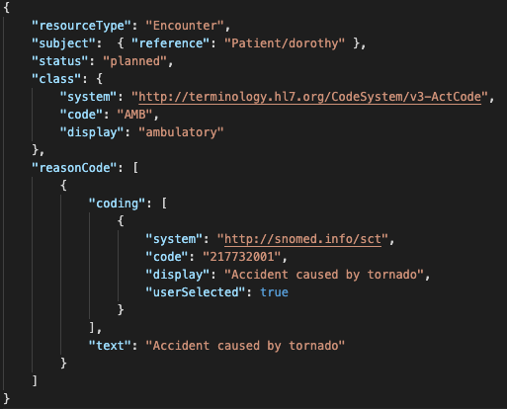
code
coding
CodeableConcept
Notes:
Once Dorothy has filled out the form, the GP system will get a record of the encounter, which might look like this if they’re using FHIR. This illustrates the 3 data types that FHIR uses to store coded data
Code (no system necessary, information model dictates which code system)
Coding (system + code, also optionally display, version, userSelected)
CodeableConcept (multiple codings, plus text). Codings inside a single CC should be equivalent (ish), not e.g. fracture of leg and fracture of arm (that is two codeable concepts!)

Slide 11
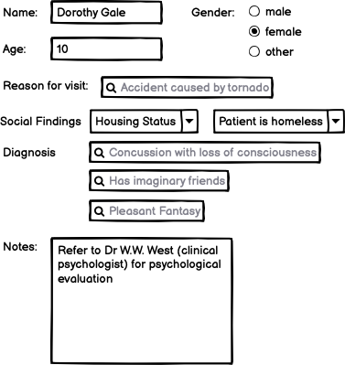
Step 2. Dr Oz makes his record
Notes:
Doctor Oz takes some encounter notes
He refers Dorothy to his colleague Dr West for a psych eval

Slide 12
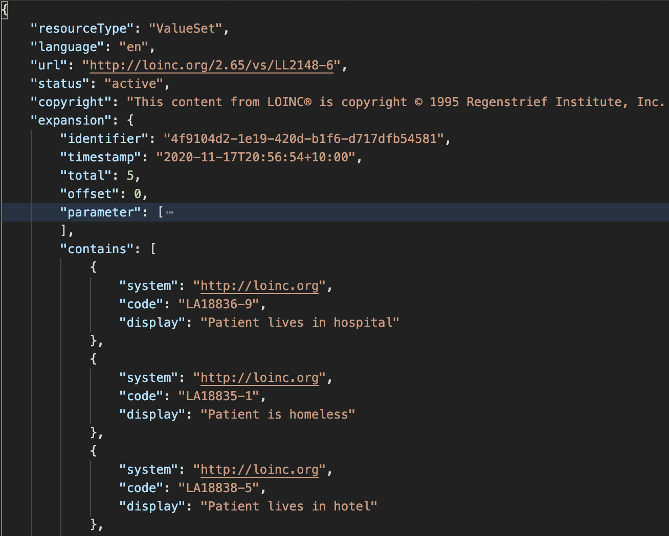
Selecting housing status
GET /ValueSet/$expand? url=http://loinc.org/vs/LL2148-6
Notes:
Some of the big standard terminologies have implicit ValueSets
LOINC has implicit ValueSets, in this case answer lists (here for housing status)

Slide 13
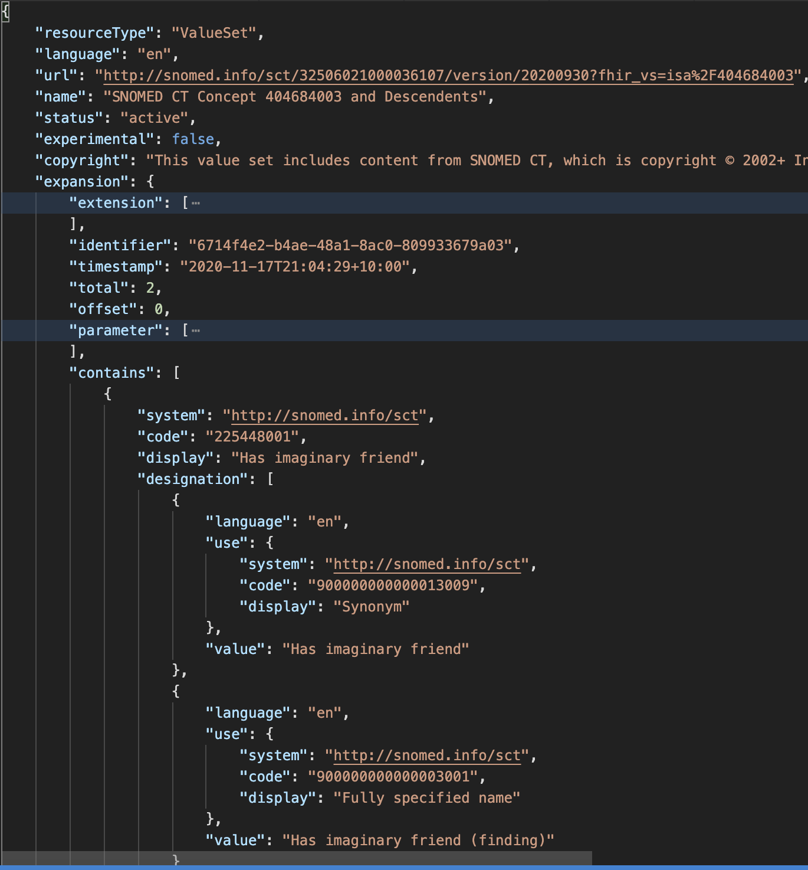
Selecting diagnosis codes
GET /ValueSet/$expand? url=http://snomed.info/sct?fhir_vs=isa/404684003& count=10& offset=0& includeDesignations=true& filter=imagina
Notes:
SNOMED also has implicit ValueSets, here based on hierarchy (all descendents of Clin Find)
This also shows how we can page using count and offset
We can also control the resulting expansion ValueSet with parameters like includeDesignations

Slide 14
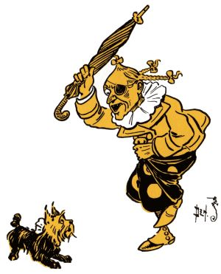
Step 3. Dr Oz sends his record to Dr West
Dr West’s EMR validates the resources when they arrive
Dr West’s EMR probably enforces some profiles of Patient/Encounter/ServiceRequest/ Condition/FamilyMemberHistory
FHIR $validate
Usually makes lots of calls to ValueSet/$validate-code
Notes:
Dr West receives the record, and her system does some validation to make sure its all legitimate

Slide 15
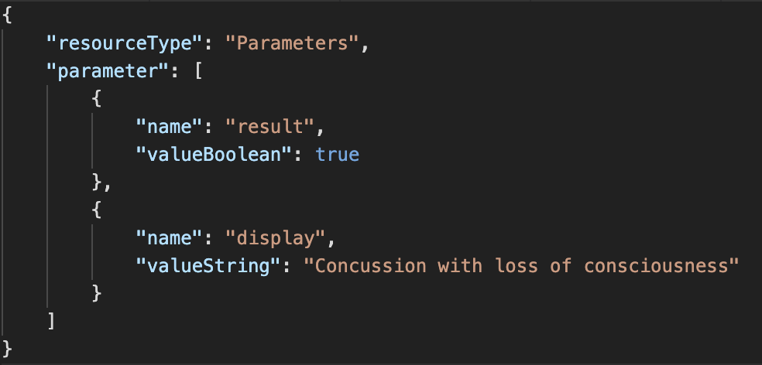
Check condition codes
GET /ValueSet/$validate-code? url=http://snomed.info/sct?fhir_vs=refset/32570071000036102& system=http://snomed.info/sct& code=62564004
Notes:
$validate code with url, system/code
Result comes back as a parameter
Result parameter true, display is a convenience

Slide 16
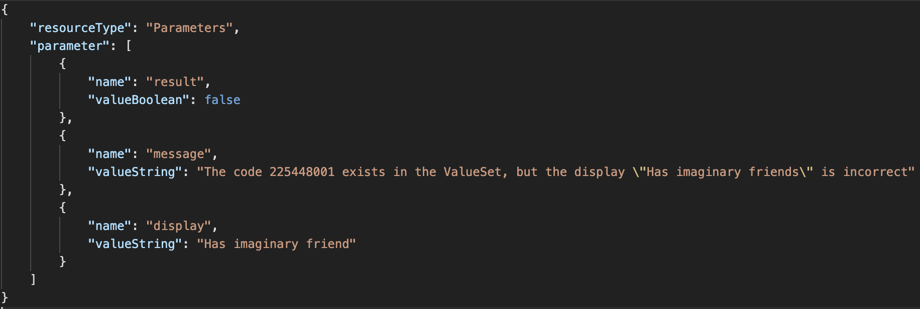
Check condition codes
GET /ValueSet/$validate-code? url=http://snomed.info/sct?fhir_vs=refset/32570071000036102& system=http://snomed.info/sct& code= 225448001& display=Has imaginary friends
Notes:
We can also check the display by passing it in with the request
Here, Dr Oz has pluralized imaginary friends, which isn’t an acceptable synonym

Slide 17
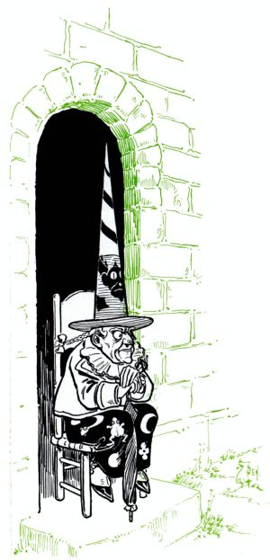
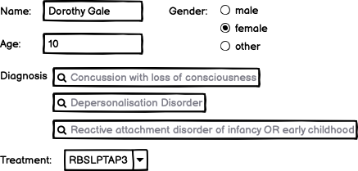
Step 4. Dr West completes her record
Notes:
Dr West diagnoses Dorothy with depersonalization disorder and reactive detachment disorder
Her system uses a local code system for the procedure codes (hence RBSLPTAP3)

Slide 18
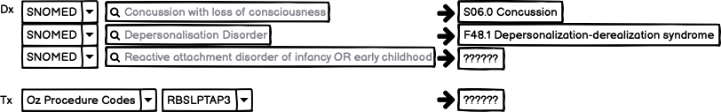
Step 5. Dr West submits her record to the HIE
Notes:
Dr West submits her record to the HIE, which does some code normalization for their billing system
The first two SNOMED codes map to ICD-10 codes, but the third doesn’t, and nor does the local code
FHIR helps us with the mapping as well as with diagnosing what went wrong with the codes that didn’t map

Slide 19
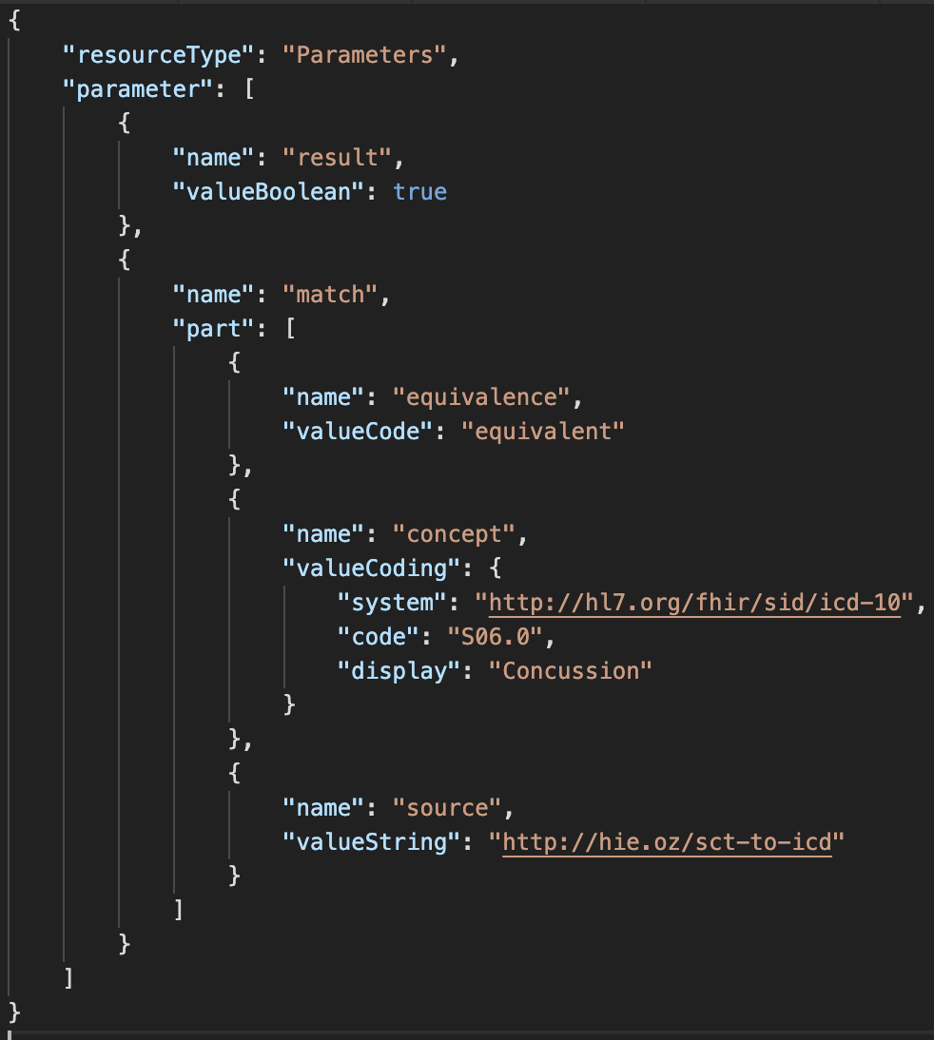
Map SNOMED codes to ICD-10 (using some ConceptMap)
GET /ConceptMap/$translate? url=http://hie.oz/sct-to-icd& target=http://hl7.org/fhir/sid/icd-10/vs& system=http://snomed.info/sct& code=62564004
Notes:
The HIE has built their own SCT-ICD10 map, because taking one off the shelf is complicated and risky
The translate operation uses the URL of this map, as well as a system/code pair (target is optional)
The result can include multiple codes, and for each one will tell us the mapping relationship that holds according to the CM

Slide 20
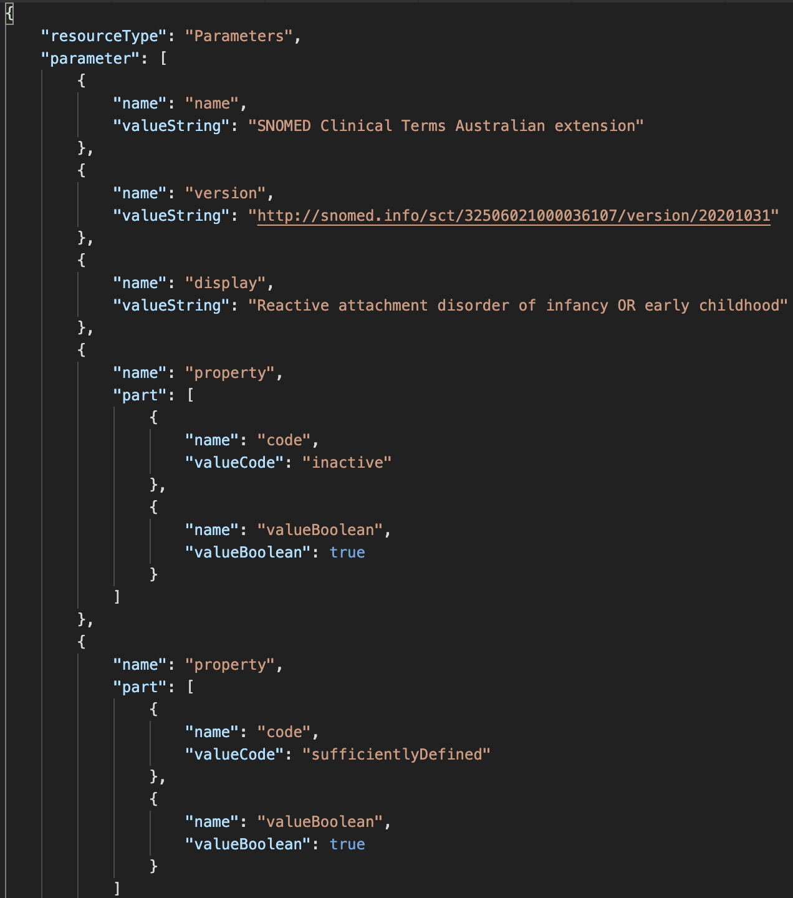
What about that unmapped code?
GET /CodeSystem/$lookup? system=http://snomed.info/sct& code=28857002
Notes:
We can can do a lookup to get more information about the unmapped code.
The server will give us the basics of the code, but it will choose the properties it thinks are interesting. If we want specific properties, we can ask for them in the request.
We can see here that the code is inactive. Fortunately, SNOMED CT gives us some tools to find out what it has been replaced by

Slide 21
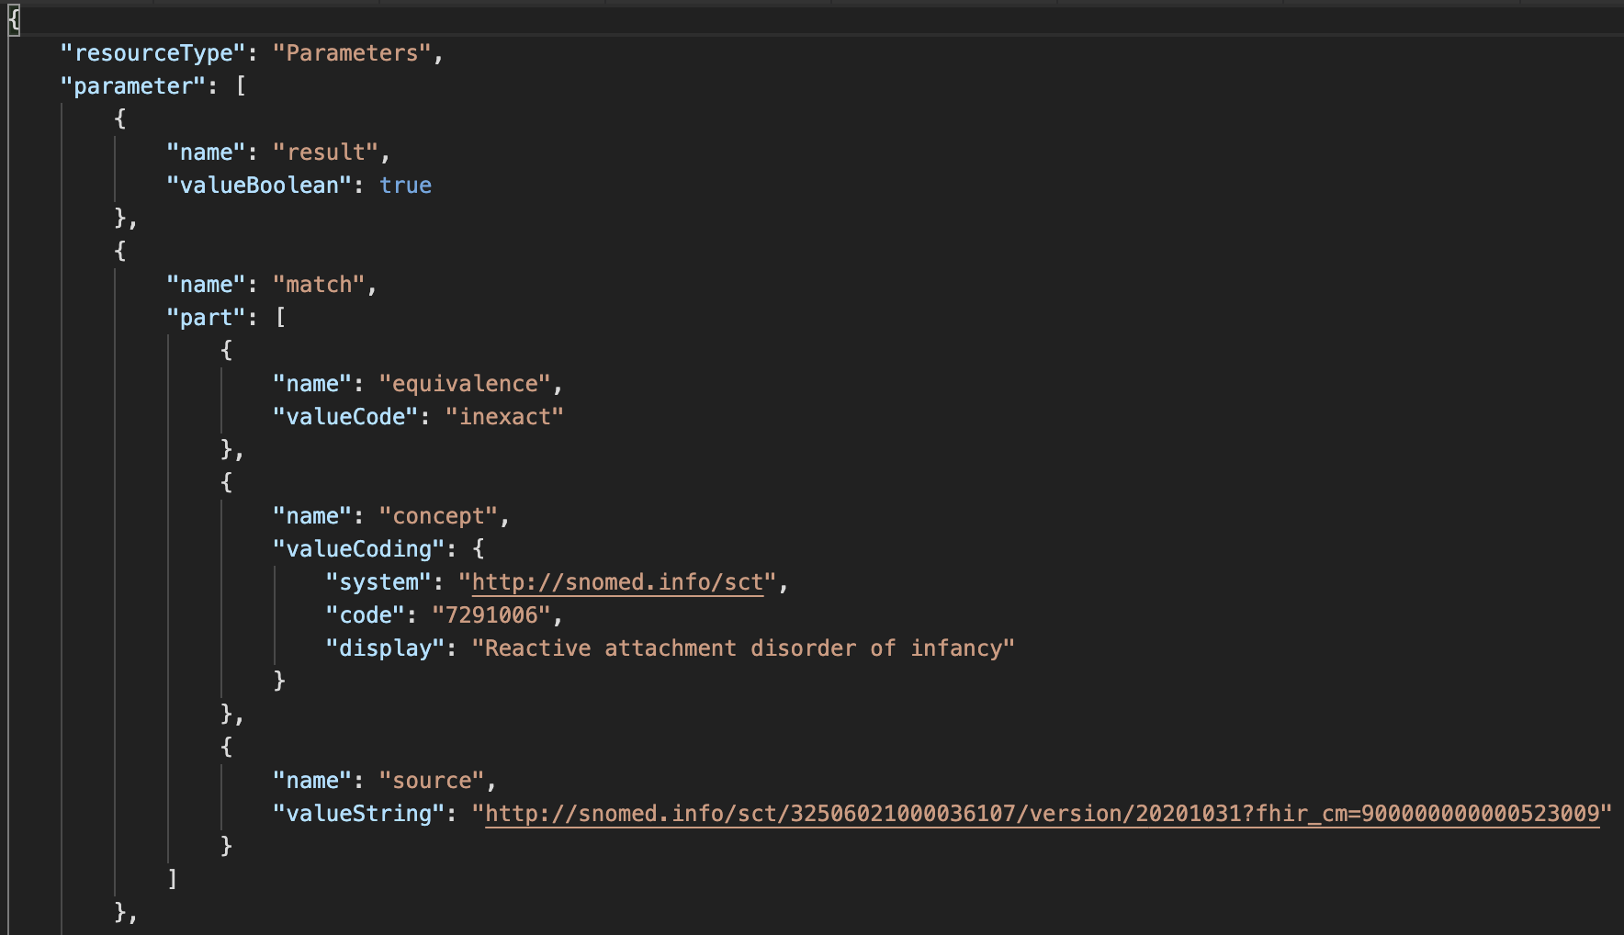
What was this inactive SNOMED CT code replaced by?
GET /ConceptMap/$translate? url=http://snomed.info/sct?fhir_cm=900000000000523009& target=http://snomed.info/sct?fhir_vs& system=http://snomed.info/sct& code=62564004
Notes:
Implicit ConceptMap!

Slide 22
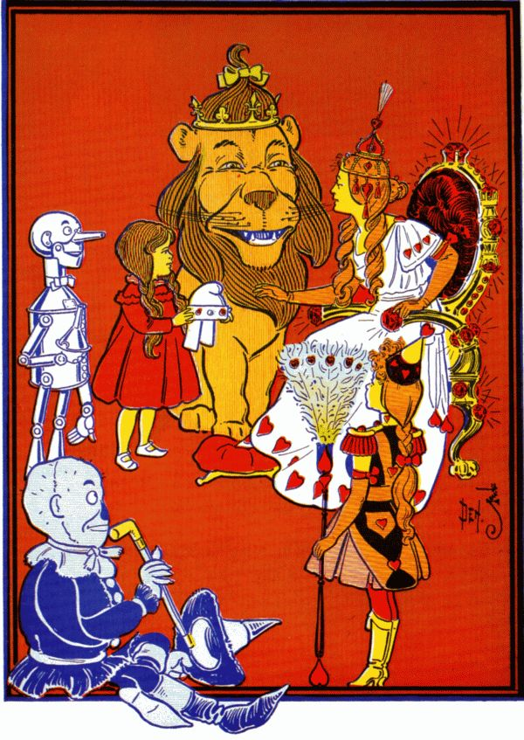
Step 6. Glinda Goodwitch is doing some analytics
She wants to find what treatment paths are being used for patients with mental health conditions
She starts with all SCT Mental Illnesses
http://snomed.info/sct?fhir_vs=isa/74732009
Notes:
Meanwhile Glinda is doing analytics, trying to study treatment paths for mental health patients
She starts with a hierarchy-based ValueSet, but later in her experiment she narrows the cohort by building her own ValueSet

Slide 23
Glinda’s FHIR server
/Patient?_has:Condition:subject:code:below=74732009
Maybe Glinda’s server is using $closure to keep a local cache of subsumption relationships among the codes it knows about.
Maybe Glinda’s server has some virtualized tables that sync with the terminology server periodically
Notes:
Glinda can use FHIR search requests that are aware of terminology to find her patient cohort
These FHIR requests require the FHIR server to be integrated with a terminology server capable of interrogating the hierarchy and the specified ValueSet
For the first ValueSet, Glinda’s server might choose to use the $closure operation to keep a local table of the hierarchy relationships that exist among all its condition codes

Slide 24
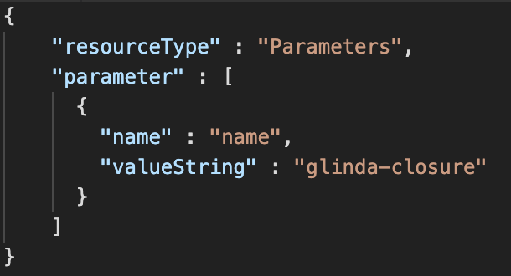
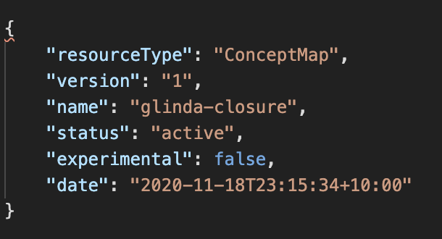
$closure (1/3)
Notes:
The first step in using a closure table is to initiate it. Here we send through a request with just a name for the table. The server will always respond with a ConceptMap, and we can use the version of the CM to check that the server is still in sync with what we expect. (If it falls out of sync, we may need to resychronize)

Slide 25
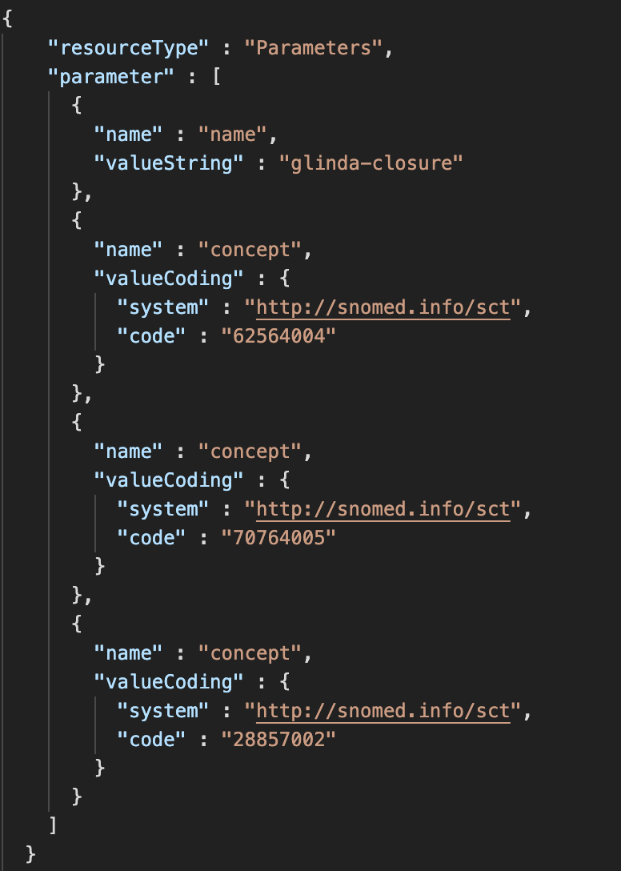
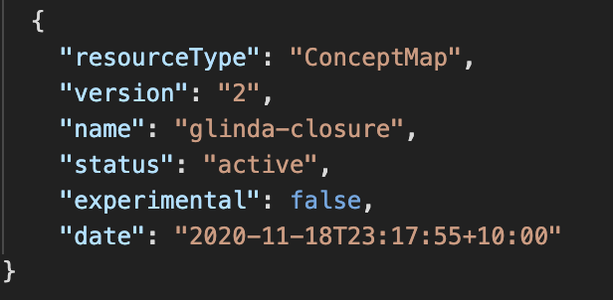
$closure (2/3
Notes:
In the next step, we send through the codes the server knows about. In this case, there are no hierarchical relationships amongst Dorothy’s diagnosis codes, so the ConceptMap comes back without any map entries again.

Slide 26
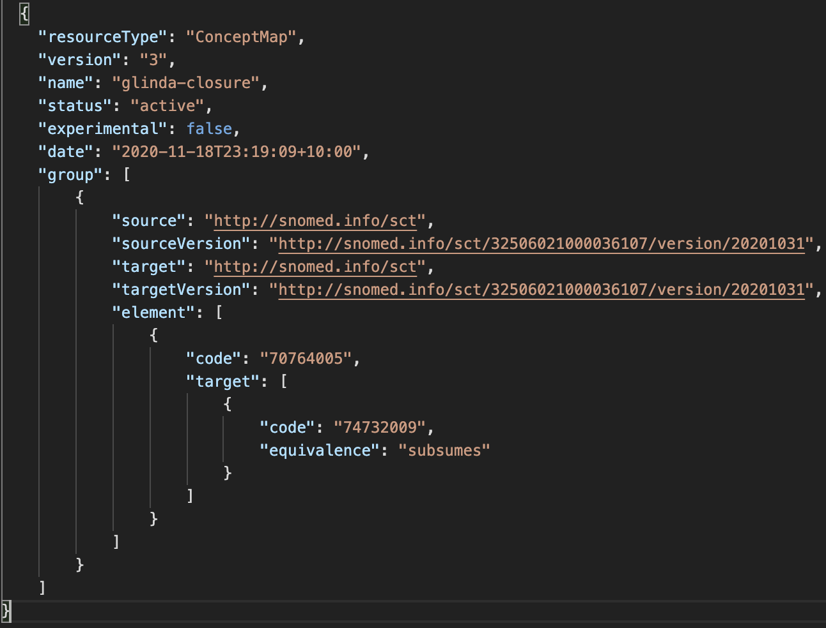
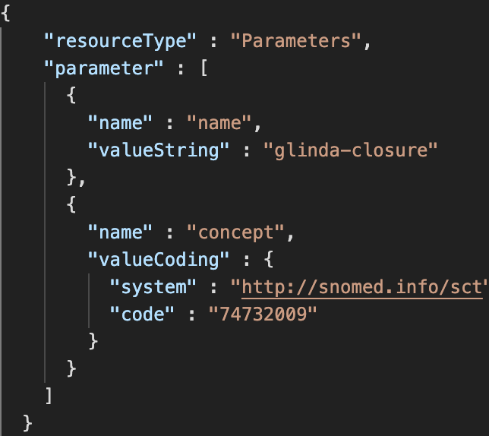
$closure (3/3)
Notes:
We then send through the mental health condition code, and the server comes back saying that the depersonalization disorder is a match. The FHIR server can then return Dorothy as a member of the cohort

Slide 27
Step 7. Glinda refines her cohort
She’s finding too many drunken munchkins
She’s also not interested in intellectual disabilities for this study, so …
Glinda makes her own ValueSet!
Notes:
Meanwhile Glinda is doing analytics, trying to study treatment paths for mental health patients
She starts with a hierarchy-based ValueSet, but later in her experiment she narrows the cohort by building her own ValueSet

Slide 28
Making a ValueSet compose
We have 4 “building blocks” criteria
a whole code system
members of another ValueSet
specific codes from a code system
a filter (property, op, value)
Multiple criteria in the same include/exclude
AND/intersection
E.g. Only members of an included ValueSet that satisfy a filter
Multiple separate include/excludes
OR/union
E.g. members of an included ValueSet as well as codes that satisfy a filter
All includes are processed before excludes
Notes:
4 building blocks that we can combine – whole code system, members of some other ValueSet, specific codes, and a filter as a property-operator-value triple. These can be combined
Same include/exclude : both must be satisfied (AND)
Different include/excludes: at least one must be satisfied (OR)
Includes first, excludes afterwards (always deterministic)

Slide 29
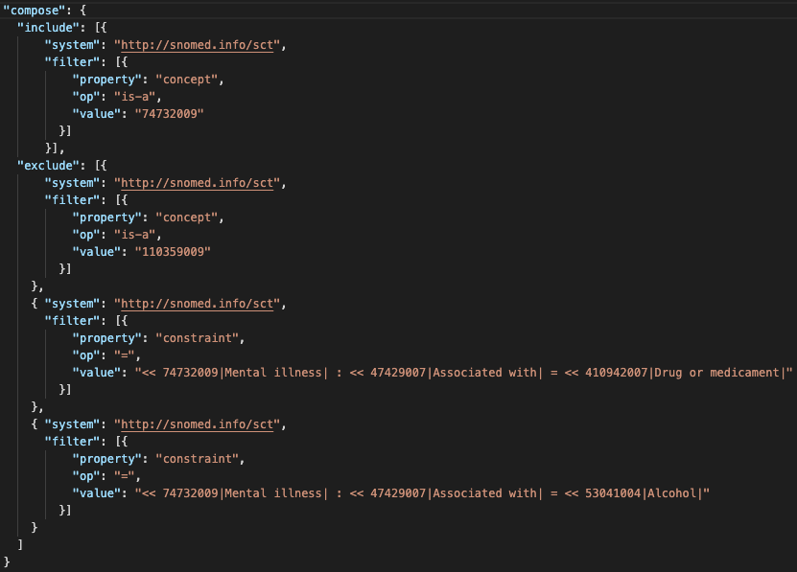
Notes:
Glinda wants all mental health disorders, minus all intellectual disabilities, minus anything with any association with drugs or alcohol

Slide 30
Glinda can test her ValueSet first
POST /ValueSet/$validate
POST /ValueSet/$expand
“Dynamic ValueSet expansion“ is also very useful for building UIs where the set of available codes is refined by selections in other fields (e.g. excluding medications from a prescription field that include known allergens/intolerances as ingredients

Slide 31
Glinda’s FHIR server (2)
/Patient?_has:Condition:subject:code:in=http://hie.oz/mental-health
Unfortunately there is no $closure equivalent for ValueSet membership
If the server is limited to only known ValueSet urls, then maybe it maintains a cache. Otherwise, maybe it just asks the server (e.g. for the intersection of the ValueSet and the server’s known Condition codes)
Notes:
Glinda can use FHIR search requests that are aware of terminology to find her patient cohort
These FHIR requests require the FHIR server to be integrated with a terminology server capable of interrogating the hierarchy and the specified ValueSet
For the first ValueSet, Glinda’s server might choose to use the $closure operation to keep a local table of the hierarchy relationships that exist among all its condition codes

Slide 32
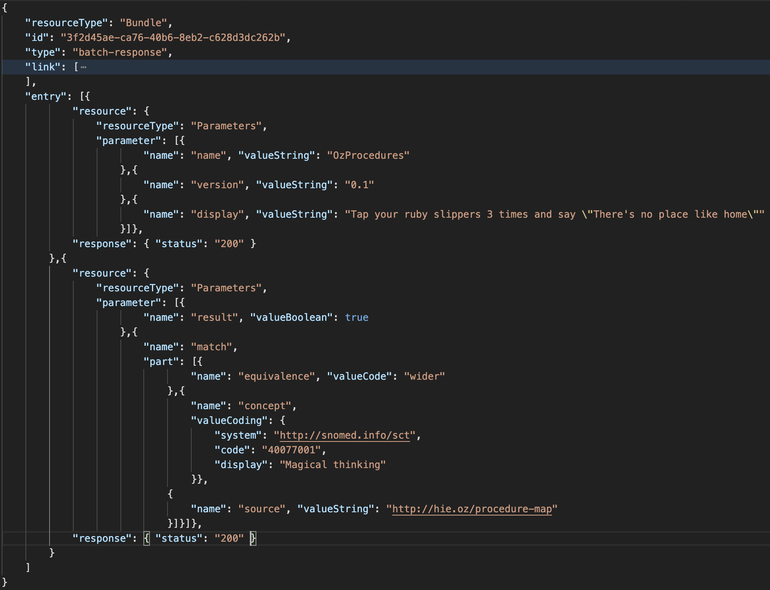
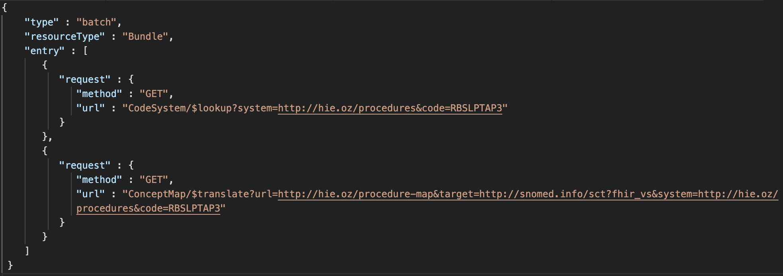
Glinda finds Dorothy!
Notes:
Having found Dorothy to be in her cohort, Glinda is interested in her treatment path. One of her colleagues has a map from the proprietary procedures code system to SNOMED CT.
Glinda discovers this procedure has been successful, so she recommends it be added to the standard treatment plan.

Slide 33
Notes:
There’s no place like home.

Slide 34
What have we learned?
Some of the terminology operations in the FHIR and what they do
$expand
List all the codes in a ValueSet, or search for a code in a ValueSet
$validate-code
Test whether a code is in a ValueSet, and test whether its display text is correct
$translate
Use a ConceptMap to find what a code maps to
$lookup
Find details about a code
$closure
Query hierarchy relationships amongst a set of codes
A quick example of making your own ValueSet
Some pathways for integration of FHIR and terminology servers!
Notes:
Recap

Slide 35
Contact
Please ask questions:
Email: ontoserver-support@csiro.au
On the FHIR Zulip in #terminology
Twitter: @ontoserver

Slide 36
Thank you
Dr Jim Steel Team Leader, Health Data & FHIR
e Jim.Steel@csiro.au
w https://ontoserver.csiro.au
Australian E-Health Research Centre

